Slide 1


WEEK 2
SPRINT 4
PL6
ENV

Slide 2


about us.

Slide 3
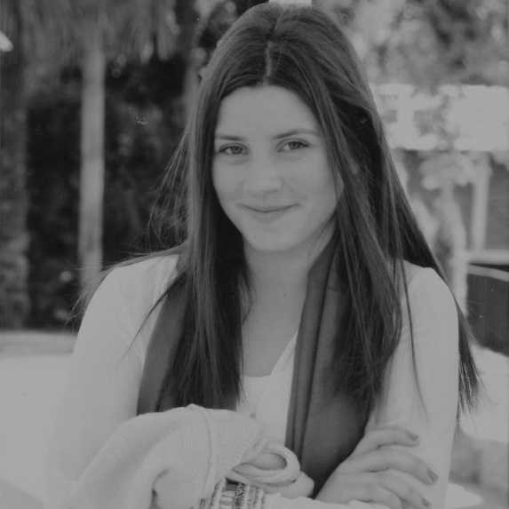
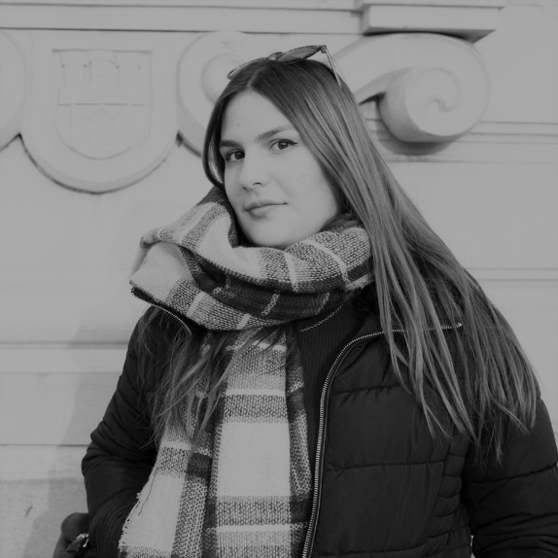
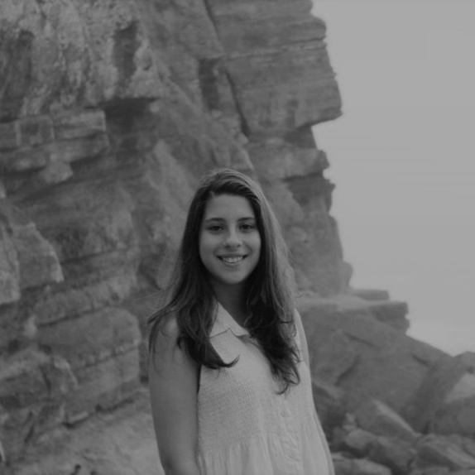
env.
Carla Mendes
Helena Tavares
Sara Costa

Slide 4
completed tasks.
 | TASK #1 | TASK #2 | TASK #3
TASK | Support to the other units | Managing Slack/GitHub/Trello | Heuristic Evaluation
OWNER | Unit | Helena Tavares | Carla Mendes
GOAL EFFORT | 1h | 25min | 2h
EFFECTIVE EFFORT | 16min | 18min | 32min
STATUS | IN PROGRESS | IN PROGRESS | IN PROGRESS(15%)

Slide 5
completed tasks.
 | TASK #4 | TASK #5 | TASK #6
TASK | Weekly Presentation | Criação de um formulário
OWNER | Carla Mendes | Sara Costa
GOAL EFFORT | 30min | 1h30min
EFFECTIVE EFFORT | 37min | 2h05min
STATUS | COMPLETED | COMPLETED

Slide 6
planned tasks.
 | TASK #1 | TASK #2 | TASK #3
TASK | Managing Slack/GitHub | Supporting the other units | Heuristic Evaluation
OWNER | Helena Tavares | Helena Tavares | Carla Mendes
GOAL EFFORT | 1h per week | 1h per week | 2h
STATUS | PLANNED | PLANNED | PLANNED

Slide 7
planned tasks.
 | TASK #4 | TASK #5 | TASK #6
TASK | Updating the Architectural Software Document
OWNER | Carla Mendes
GOAL EFFORT | 1h
STATUS | PLANNED

Slide 8
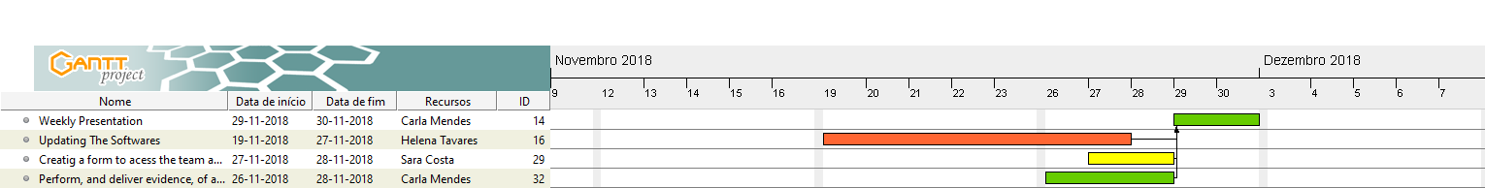
gantt diagram - effort.

Slide 9
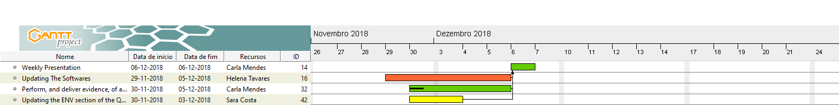
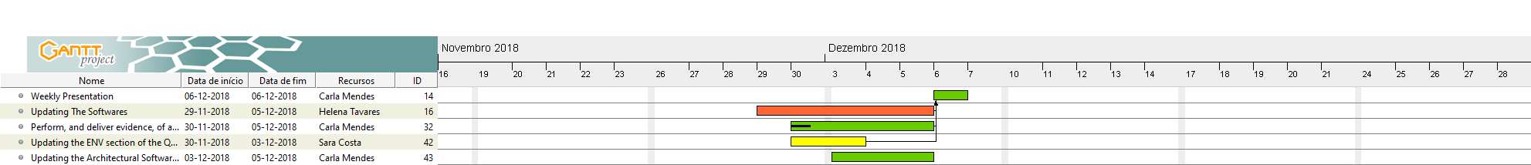
gantt diagram - planned.

Slide 10
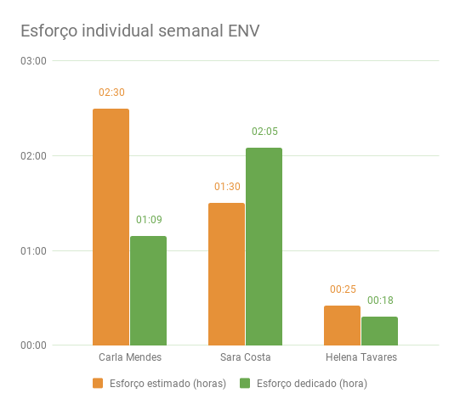
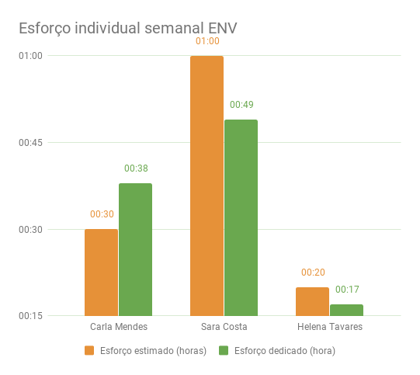
bar graph.

